Slide 1
MATH-352 Numerical Methods
Atifa Kanwal
atifa.kanwal@seecs.edu.pk
Office # 303, Faculty Block, SEECS, NUST

Slide 2
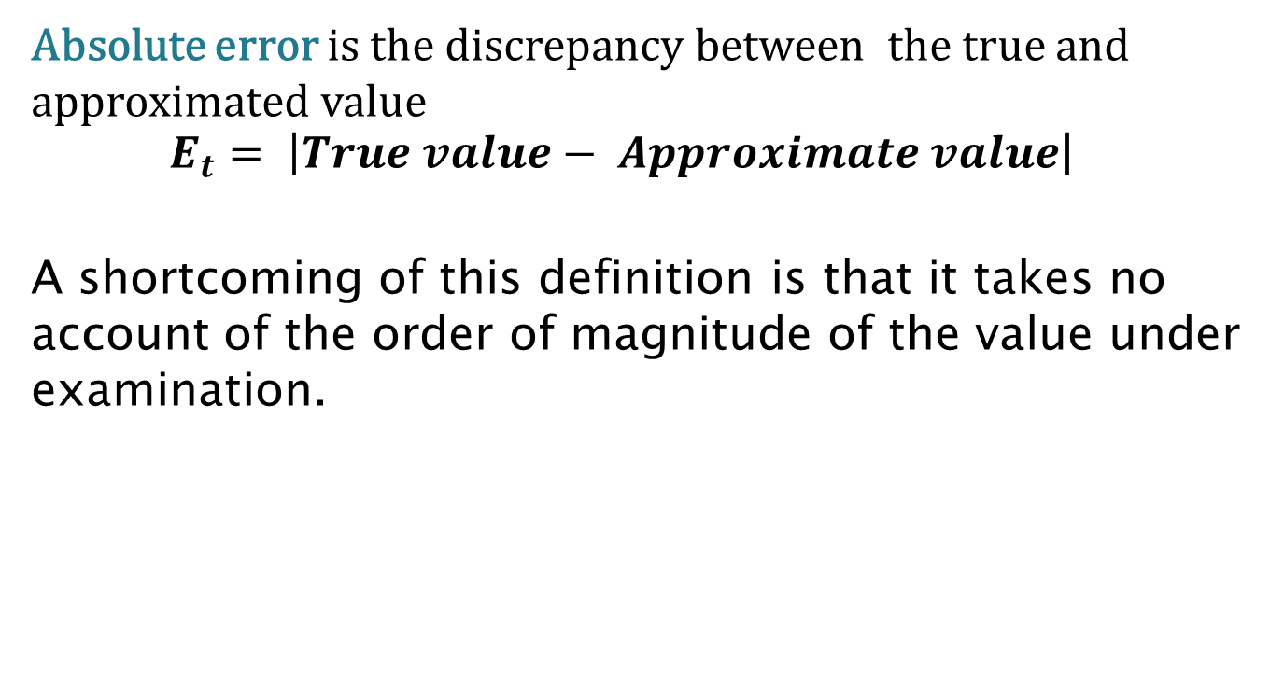
Error Definitions
Absolute error is the discrepancy between the true and approximated value
$$E_{t}= \left|True value− Approximate value\right|$$
A shortcoming of this definition is that it takes no account of the order of magnitude of the value under examination.

Slide 3
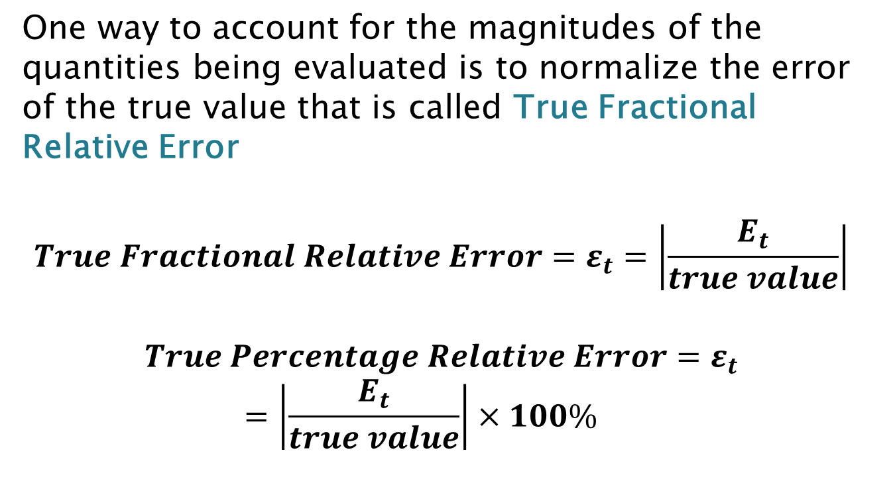
Error Definitions:Cont…
One way to account for the magnitudes of the quantities being evaluated is to normalize the error of the true value that is called True Fractional Relative Error
$$True Fractional Relative Error=ε_{t}=\left|\frac{E_{t}}{true value}\right|$$
$$True Percentage Relative Error=ε_{t}=\left|\frac{E_{t}}{true value}\right|×100\%$$

Slide 4
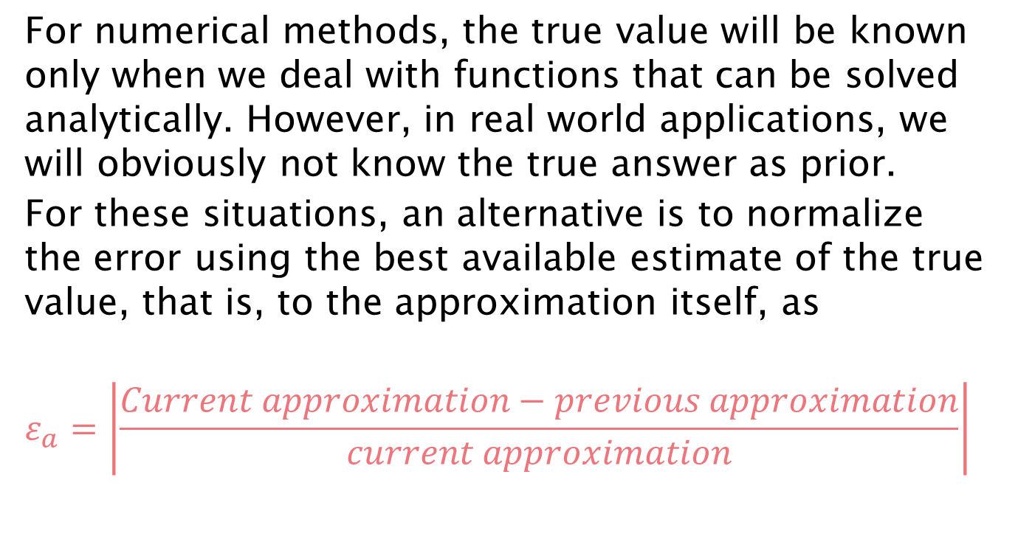
Error Definitions:Cont…
For numerical methods, the true value will be known only when we deal with functions that can be solved analytically. However, in real world applications, we will obviously not know the true answer as prior.
For these situations, an alternative is to normalize the error using the best available estimate of the true value, that is, to the approximation itself, as
$$ε_{a}=\left|\frac{Current approximation−previous approximation}{current approximation}\right|$$

Slide 5
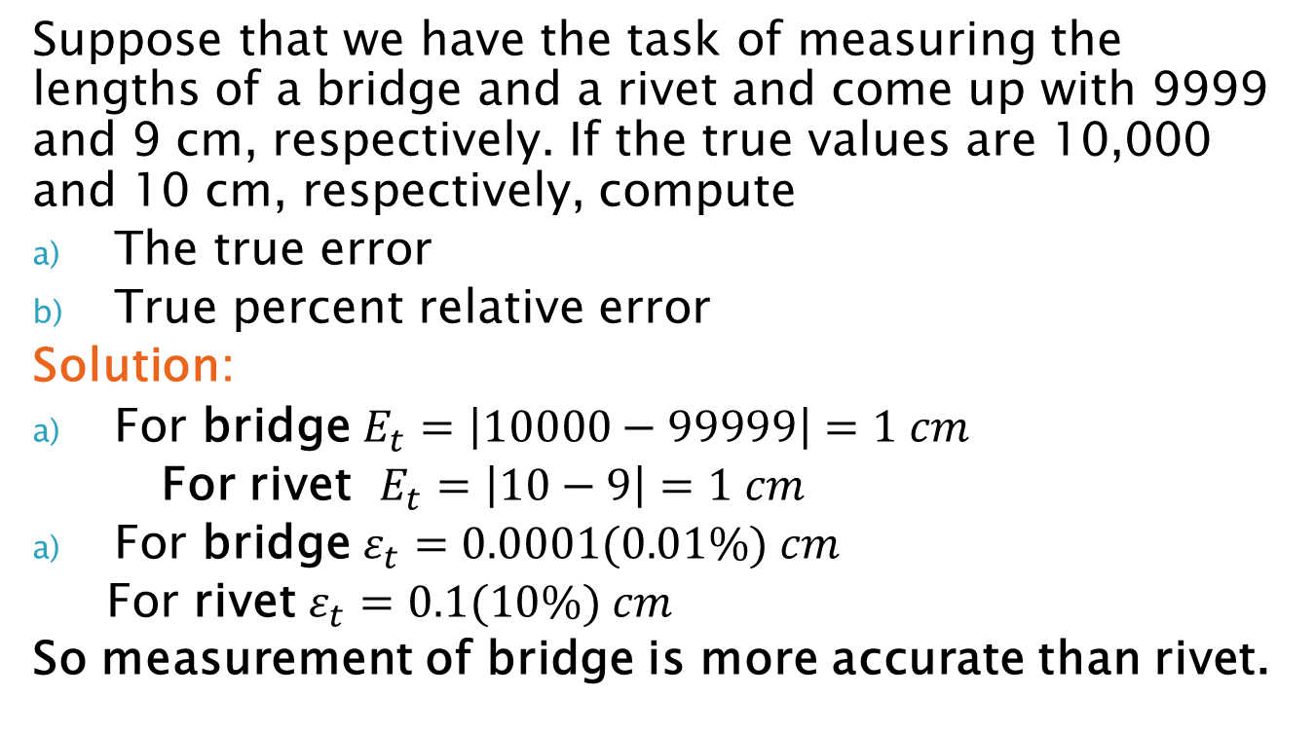
Error Definitions: Example
Suppose that we have the task of measuring the lengths of a bridge and a rivet and come up with 9999 and 9 cm, respectively. If the true values are 10,000 and 10 cm, respectively, compute
The true error
True percent relative error
Solution:
For bridge $E_{t}=\left|10000−99999\right|=1 cm$
For rivet $E_{t}=\left|10−9\right|=1 cm$
For bridge $ε_{t}=0.0001(0.01\%) cm$
For rivet $ε_{t}=0.1(10\%) cm$
So measurement of bridge is more accurate than rivet.

Slide 6
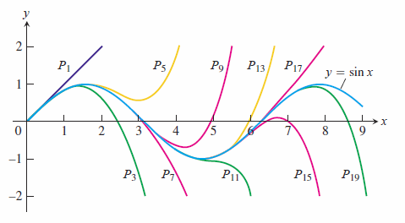
Taylor Series and Truncation error

Slide 7
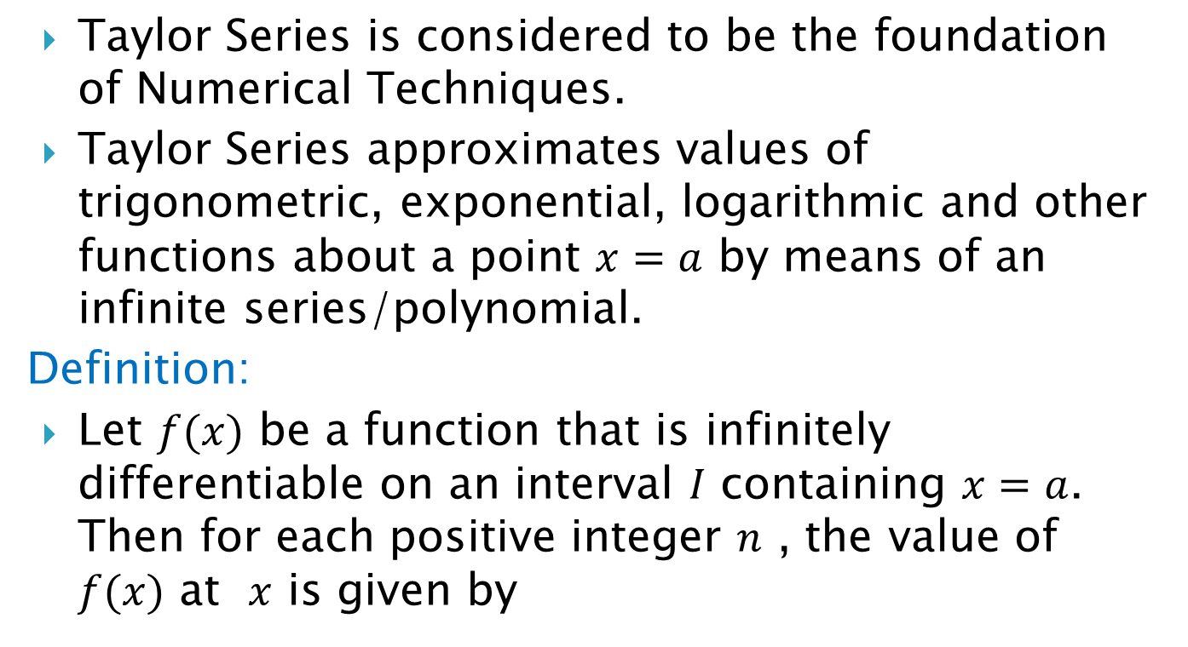
Taylor Series
Taylor Series is considered to be the foundation of Numerical Techniques.
Taylor Series approximates values of trigonometric, exponential, logarithmic and other functions about a point $x=a$ by means of an infinite series/polynomial.
Definition:
Let $f(x)$ be a function that is infinitely differentiable on an interval $I$ containing $x=a$. Then for each positive integer $n$ , the value of $f(x)$ at $x$ is given by

Slide 8
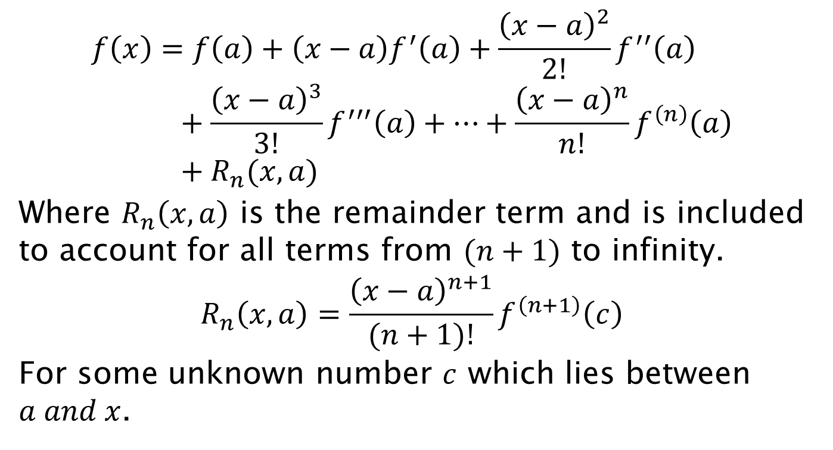
Taylor Series Cont…
$$f\left(x\right)=f\left(a\right)+\left(x−a\right)f^{′}\left(a\right)+\frac{{\left(x−a\right)}^{2}}{2!}f^{′′}\left(a\right)+\frac{{\left(x−a\right)}^{3}}{3!}f^{′′′}\left(a\right)+…+\frac{{\left(x−a\right)}^{n}}{n!}f^{\left(n\right)}\left(a\right)+R_{n}(x,a)$$
Where $R_{n}\left(x,a\right)$ is the remainder term and is included to account for all terms from $(n+1)$ to infinity.
$$R_{n}\left(x,a\right)=\frac{{\left(x−a\right)}^{n+1}}{(n+1)!}f^{\left(n+1\right)}\left(c\right)$$
For some unknown number $c$ which lies between $a and x$.

Slide 9
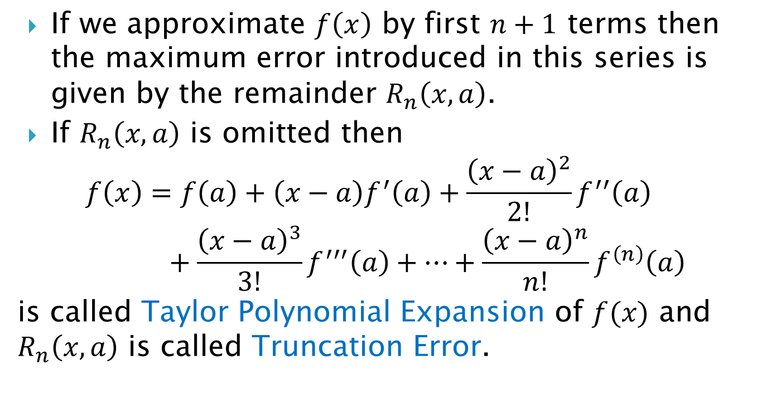
Taylor Series Cont…
If we approximate $f\left(x\right)$ by first $n+1$ terms then the maximum error introduced in this series is given by the remainder $R_{n}\left(x,a\right)$.
If $R_{n}\left(x,a\right)$ is omitted then
$$f\left(x\right)=f\left(a\right)+\left(x−a\right)f^{′}\left(a\right)+\frac{{\left(x−a\right)}^{2}}{2!}f^{′′}\left(a\right)+\frac{{\left(x−a\right)}^{3}}{3!}f^{′′′}\left(a\right)+…+\frac{{\left(x−a\right)}^{n}}{n!}f^{\left(n\right)}\left(a\right)$$
is called Taylor Polynomial Expansion of $f(x)$ and $R_{n}\left(x,a\right)$ is called Truncation Error.

Slide 10
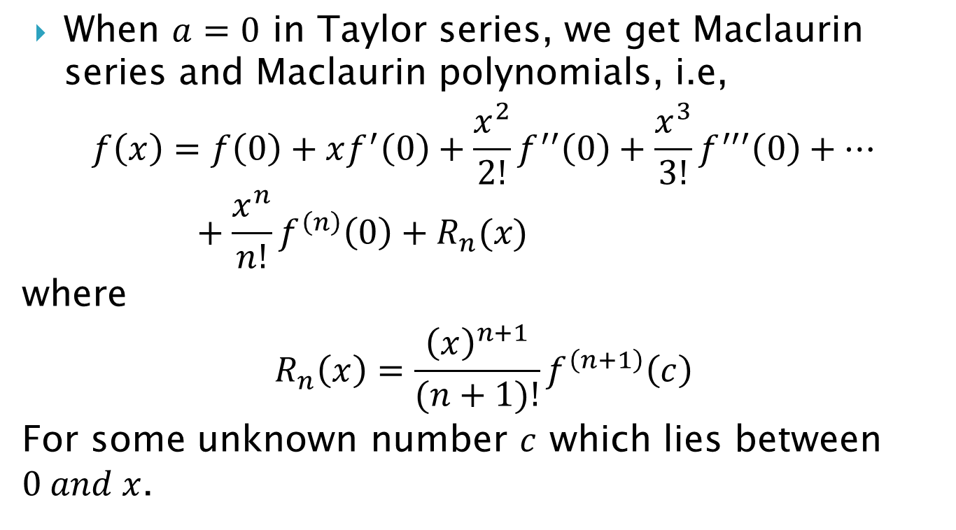
Maclaurin series
When $a=0$ in Taylor series, we get Maclaurin series and Maclaurin polynomials, i.e,
$$f\left(x\right)=f\left(0\right)+xf^{′}\left(0\right)+\frac{x^{2}}{2!}f^{′′}\left(0\right)+\frac{x^{3}}{3!}f^{′′′}\left(0\right)+…+\frac{x^{n}}{n!}f^{\left(n\right)}\left(0\right)+R_{n}(x)$$
where
$$R_{n}\left(x\right)=\frac{{\left(x\right)}^{n+1}}{(n+1)!}f^{\left(n+1\right)}\left(c\right)$$
For some unknown number $c$ which lies between $0 and x$.

Slide 11
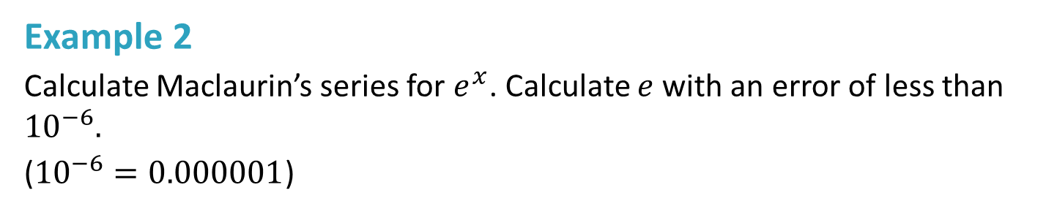
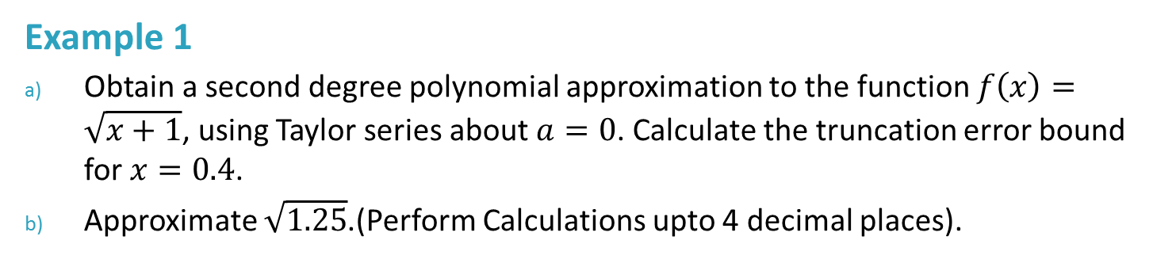
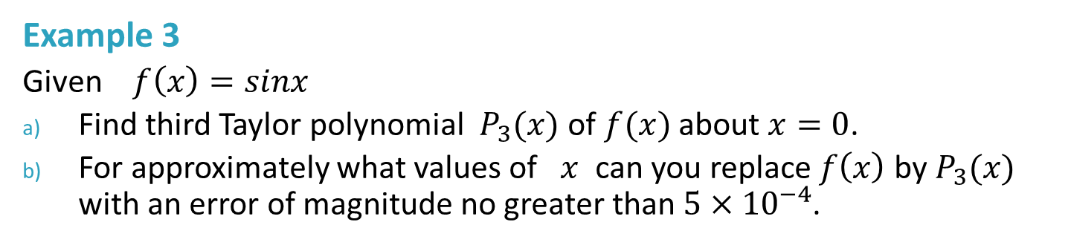
Example 1
Obtain a second degree polynomial approximation to the function $f\left(x\right)=\sqrt{x+1}$, using Taylor series about $a=0$. Calculate the truncation error bound for $x=0.4$.
Approximate $\sqrt{1.25}$.(Perform Calculations upto 4 decimal places).
Example 2
Calculate Maclaurin’s series for $e^{x}$. Calculate $e$ with an error of less than ${10}^{−6}.$
(${10}^{−6}=0.000001$)
Example 3
Given $f\left(x\right)=sinx$
Find third Taylor polynomial $P_{3}(x)$ of $f(x)$ about $x=0$.
For approximately what values of $x$ can you replace $f\left(x\right)$ by $P_{3}(x)$ with an error of magnitude no greater than $5×{10}^{−4}$.

